Slide 1




Data Upload & Persistence
Smart Energy Overview
Dr. Happy Monday,
Dr. Grace Nneji,
Associate Professor
CDUT Summer School
Associate Professor

Slide 2


Goal:
Build AI dashboards that support:
File uploads
Personal prediction logs
Historical analysis dashboards
Tech Stack: Streamlit + Supabase Storage + Supabase Postgres

Slide 3






Key Concepts
Persistence
Bucket
ACL
Prediction Log
Dashboard
Storing data across sessions.
Supabase’s top-level storage namespace
Access control rules for file permissions
Table row of inputs + outputs + metadata
Personalized UI for user’s file history and trends

Slide 4




Why Persistence Matters?
✅ Traceability – Enables audit trails & reproducible research
✅ User Experience – Revisits prior uploads
✅ Data Governance – One source of truth
✅ Monetization – Tiers based on upload history

Slide 5







Supabase Storage vs AWS S3
Feature | S3 | Supabase
Built-in Auth | ❌ | ✅ JWT-based
Upload UI | ❌ | ✅ Streamlit UI
Metadata in DB | Manual | ✅ Auto via storage.objects

Slide 6



Create Upload Bucket
Steps:
Go to Supabase → Storage → New Bucket
Name it uploads
Set to Public for simplicity (use Private + RLS in production)
Note the public path for uploads:

Slide 7
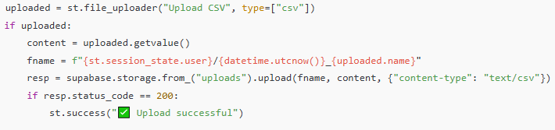




Upload Workflow in Streamlit

Slide 8
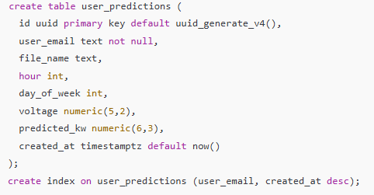
Prediction Log Table (SQL)
Log ID: Unique identifier for each prediction entry.
Prediction Result: Stores the result of each prediction made.
Timestamp: Records the date and time of each prediction.
🔍 Enables time-series logs and file-linked predictions.

Slide 9
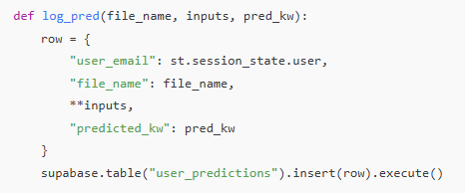
Logging Predictions
Use a timestamp to record when predictions are made.
Store prediction results in a dedicated SQL table.
Implement error handling to capture any issues during logging.
✅ Logs are auto-populated in Supabase.

Slide 10




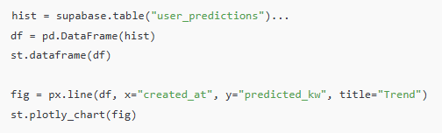

Personal Dashboard UI
Visual representation
of machine learning predictions
This dashboard displays real-time data and insights for effective decision-making.

Slide 11

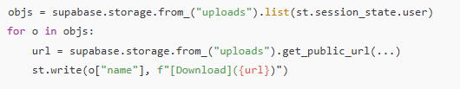
File Listing & Download
Retrieving file via Download
Use list_files() to retrieve files from storage.
Implement download_file(file_name) for direct downloads.
💡 Use signed URLs for private buckets:

Slide 12

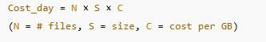
Validation & Security Tips
Rick | Mitigation
DDOS via big files | Set max file size in st.file_uploader
Malicious uploads | Restrict to csv, validate MIME type
Data leaks | Use private buckets + RLS
PII exposure | Log minimal info or use hashed IDs
📘 Cost Formula:

Slide 13
Key Takeaways
Persistent storage enhances traceability and user engagement
Supabase Storage integrates easily with Streamlit
Dashboards with upload history & trend analysis increase value
Always use secure practices with private buckets and access control

Slide 14


Thank You for Listening

